Slide 1
Part II: System Implementation
Chapter 4: Defining Performance and Choosing a Measurement Approach
Chapter 5: Measuring Results and Behaviors
Chapter 6: Performance Analytics
Chapter 7: Rolling Out the Performance Management System

Slide 2
Chapter 4
Defining Performance and
Choosing a Measurement Approach

Slide 3
Overview
Defining Performance
Determinants of Performance
Performance Dimensions
Approaches to Measuring Performance

Slide 4

Company Spotlight
Sprint uses five core dimensions to define what successful performance looks like
Both task and contextual performance are measured
Includes:
  Employees write behavioral examples of how they have performed on each dimension
  Employees are evaluated not only on results, but also on how they are achieved through working with others

Slide 5
Defining Performance
Performance is:
Behaviors and actions
  What employees do

Slide 6
Defining Performance
Performance is:
Results and Products
  The outcome of employee behaviors

Slide 7
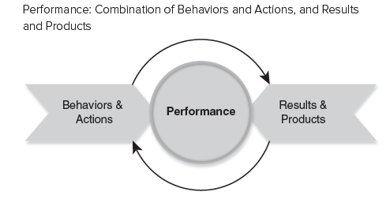
Defining Performance

Slide 8
Behaviors Labeled as Performance Are…
Evaluative
Negative
Neutral
Positive
Multidimensional
Many different kinds of behaviors
Advance or hinder organizational goals

Slide 9
Behaviors Are NOT Always…
  Observable
  Measurable

Slide 10
Results or Products May Be Used…
To infer behavior
As proxy for behavioral measure

Slide 11
Determinants of Performance
Performance =
Abilities and other traits
X
Knowledge and skills
X
Context

Slide 12
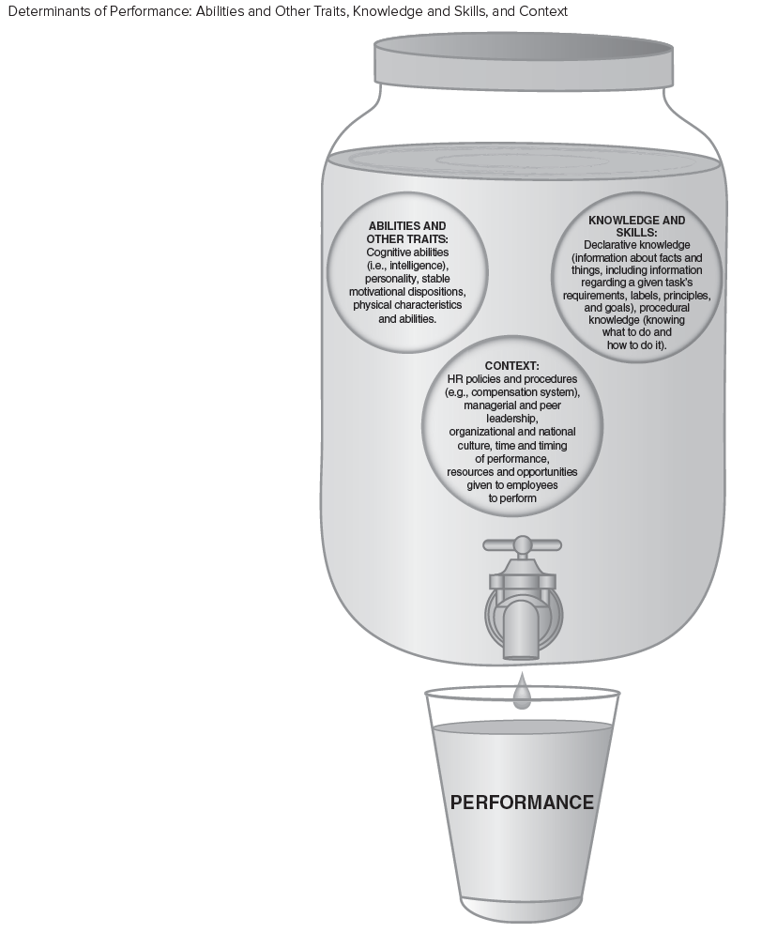
Determinants of Performance

Slide 13
Abilities and Other Traits
Cognitive Abilities
Personality
Stable Motivational Dispositions
Physical Characteristics and Abilities

Slide 14
Knowledge and Skills
Job-Related Knowledge
Skills, Attitudes and Malleable Motivational States

Slide 15
Declarative Knowledge
Information about
  Facts
  Labels
  Principles
  Goals
Understanding of task requirements

Slide 16
Procedural Knowledge
Knowing
  What to do
  How to do it
Skills
  Cognitive
  Physical
  Perceptual
  Motor
  Interpersonal

Slide 17
Context
HR Policies and Procedures (e.g., compensation system)
Managerial and Peer Leadership
Organizational and National Culture
Issues about time and timing of performance
Resources and opportunities given to employees

Slide 18
Abilities and Other Traits, and Knowledge and Skills
Knowledge and Skills are more malleable (i.e., easier to change)
Individual differences that are easier to change through interventions are called “states”

Slide 19
Motivation
Choices
  Expenditure of effort (”state” motivation)
  Level of effort (“state” motivation)
  Persistence of effort (stable trait)
Deliberate practice leads to excellence

Slide 20
Deliberate Practice
Approach performance with goal of getting better and better
Focus on performance
  What is happening?
  Why?
Seek feedback from expert sources
Build mental models of job, situation, and organization
Repeat first four steps on an ongoing basis

Slide 21
Deliberate Practice
https://www.youtube.com/watch?v=1-sjUoGO250
What are some of the tips to perform deliberate practice well?
What are some of the benefits of deliberate practice?

Slide 22
Context
HR policies and procedures
Managerial and peer leadership
Organizational and national culture
Time and timing of performance
Resources given to employees

Slide 23
Implications for Addressing Performance Problems
Managers need information to accurately identify source(s) of performance problems
Performance management systems must…
  Measure performance
      AND
  Provide information on source(s) of problems

Slide 24
Performance Dimensions:
Types of Multidimensional Behaviors
Task performance
Contextual performance
  Prosocial behaviors
  Organizational citizenship
Counterproductive performance
Adaptive Performance

Slide 25
Task Performance
Activities that
Transform raw materials
Help with the transformation process
  Replenishing
  Distributing
  Supporting

Slide 26
Contextual Performance
Behaviors that
Contribute to the organization’s effectiveness
  AND
Provide a good environment in which task performance can occur

Slide 27
Differences Between
Task and Contextual Performance
Task Performance
  Varies across jobs
  Likely to be role prescribed
  Influenced by
    Abilities
    Skills
Contextual Performance
  Fairly similar across jobs
  Not likely to be role prescribed
  Influenced by
    Personality

Slide 28
Why Include Task and Contextual
Performance Dimensions in PM System?
Global competition
Customer service
Teamwork
Employee perceptions of PM
Supervisor views
Cultural differences

Slide 29
Voice Behavior
Behavior that emphasizes expression of constructive challenge with the goal to improve rather than merely criticize
Challenges the status quo in a positive way
Makes innovative suggestions for change
Recommends modifications to standard procedures

Slide 30
Counterproductive Performance
Behaviors and results that are voluntary
and violate organizational norms
Threaten well-being of the organization, its members, or both

Slide 31
Examples of counterproductive performance
Exaggerating hours worked
Gossiping about coworkers and one’s supervisor
Cyberloafing
Intentionally working slowly and carelessly
Staying out of sight to avoid work

Slide 32
Adaptive Performance
Related to an individual’s adaptability to changes
  Be it in the organization and it’s goals,
  in the requirements of the job,
  or the overall work context
Becoming increasingly important due to rapid changes

Slide 33
Examples of adaptive performance
Handling emergencies
Solving problems creatively
Dealing with uncertain and unpredictable work situations
Demonstrating interpersonal adaptability
Demonstrating cultural adaptability

Slide 34
Approaches to Measuring Performance
Behavior Approach
Emphasizes how employees do the job
Results Approach
Emphasizes what employees produce

Slide 35
Behavior Approach
Appropriate if…
Link between behaviors and results is not obvious
Outcomes occur in the distant future
Poor results are due to causes beyond the performer’s control
Not appropriate if…
Above conditions are not present

Slide 36

Company Spotlight
Dollar General uses a behavioral approach to measure performance
Identified behaviors that serve as indicators of underlying competencies
Behaviors are reviewed and utilized to encourage certain outcomes and provide
feedback and rewards to staff members

Slide 37
Results Approach
Advantages:
  Less time
  Lower cost
  Data appear objective
Most appropriate when:
  Workers skilled in necessary behaviors
  Behaviors and results obviously related
  Consistent improvement in results over time
  Many ways to do the job right

Slide 38

Company Spotlight
Basecamp divides its employees workload into six-week work cycles containing 1-2 “big batch projects” and 4-8 “small batch projects”
Uses a results-approach to performance planning
Company focuses exclusively on getting the project done within 6 weeks and does not measure efficiency or compare actual to estimated costs
Team decides how to get the project done

Slide 39
Measuring Performance
https://www.youtube.com/watch?v=Jz8xBkQCpuE&amp=&t=48s
What kind of approach to measuring performance is used at Pfizer?
How is the focus on measuring performance based on patient figures different than sales figures? What are some of the benefits of this approach?
Is this an appropriate approach to measuring performance for Pfizer? Why or why not?

Slide 40
Quick Review
Defining Performance
Determinants of Performance
Performance Dimensions
Approaches to Measuring Performance

Slide 41

All rights reserved. No part of this publication may be reproduced, stored in a retrieval system, or transmitted, in any form or by any means, electronic, mechanical, photocopying, recording, or otherwise, without the prior written permission of the publisher. Printed in the United States of America.
Copyright © 2019 Chicago Business Press

